Slide 1

Automatic detection of unexpected accidents under bad CCTV monitoring conditions
Under the Guidance of
Dr . Suresh Dara , Professor
Department of Computer Science & Engineering
B V Raju Institute of Technology, Narsapur
Presented by
Sawan Dasari : 17211a0558
CH.Abhinav Goud : 17211a0547
B.Srikar Raju : 17211a0534
D. Rama Raghava Raju : 17211a0556

Slide 2
Abstract
Abstract
Introduction
Existing System
Proposed System
Software/Hardware Requirements
Modules
Data Flow Diagrams/Algorithms/Techniques
References
In this project, Object Detection and Tracking System (ODTS) in combination with a well-known deep learning network, Faster Regional Convolution Neural Network (Faster R-CNN), for Object Detection and Conventional Object Tracking algorithm will be introduced and applied for automatic detection and monitoring of unexpected events on CCTVs. ODTS accepts a video frame in time as an input to obtain Bounding Box (BBox) results by Object Detection and compares the BBoxes of the current and previous video frames to assign a unique ID number to each moving and detected object. This system makes it possible to track a moving object in time, which is not usual to be achieved in conventional object detection frameworks. A deep learning model in ODTS was trained with a dataset of event images in tunnels to Average Precision (AP) values of 0.8479, 0.7161 and 0.9085 for target objects: Car, Person, and Fire, respectively. Then, based on trained deep learning model, the ODTS based CCTV Accident Detection System will be tested using four accident videos which including each accident. As a result, the system can detect all accidents within 10 seconds. The more important point is that the detection capacity of ODTS could be enhanced automatically without any changes in the program codes as the training dataset becomes rich.

Slide 3
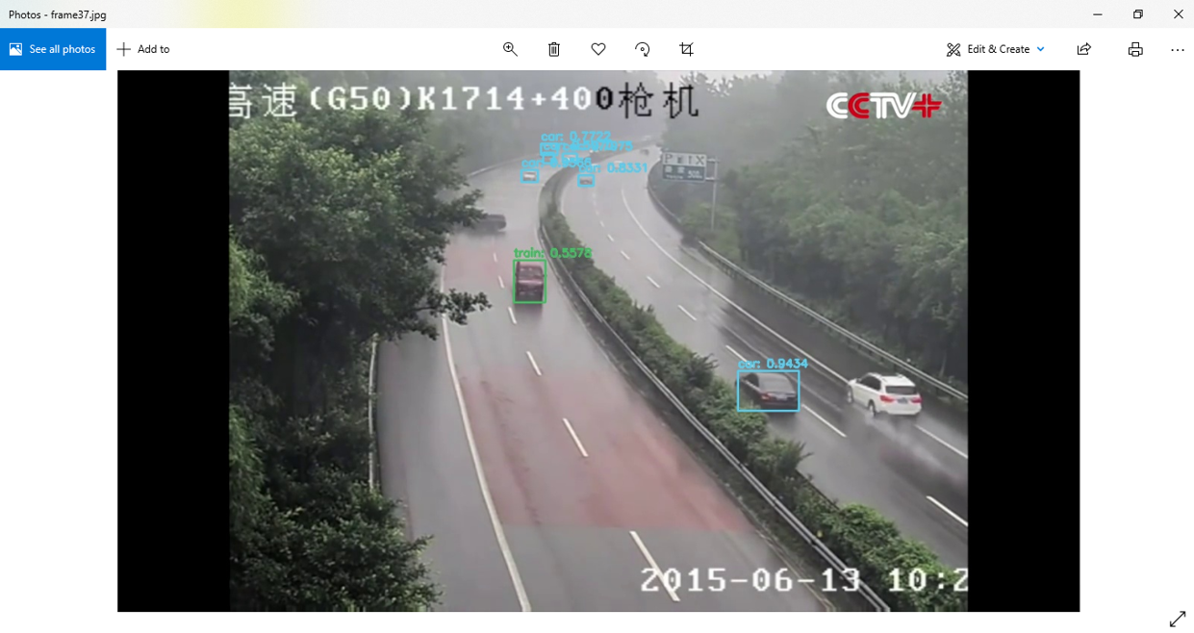
Abstract
Introduction
Existing System
Proposed System
Software/Hardware Requirements
Modules
Data Flow Diagrams/Algorithms/Techniques
References
Abstract
Introduction
Existing System
Proposed System
Software/Hardware Requirements
Architecture Model
Modules
UML Diagrams/ER Diagrams/Flow Charts
References
Introduction
Object detection technology has been successfully applied to find the size and position of target objects appearing on images or videos. Several applications have appeared mainly in self-driving of vehicles, CCTV monitoring and security system, cancer detection, etc. Object tracking is another area in image processing to be achieved by unique identification and tracking the positions of identified objects over time. However, to track objects, it is necessary to define object class and position first in a firstly given static image by object detection. Therefore, it can be said that the results of object tracking should be deeply dependent on the performance of the object detection involved. This object tracking technology has been successfully utilized for
tracing of targeted pedestrian and the
moving vehicle, accident monitoring in
Traffic camera, criminal and security
monitoring in the certain local area of
concern, etc.

Slide 4
Abstract
Introduction
Existing System
Proposed System
Software/Hardware Requirements
Modules
UML Diagrams/ER Diagrams/Flow Charts
References
Existing System
In the existing system detects vehicle object and classifies the type of vehicle by Convolutional Neural Network (CNN). The vehicle object tracking algorithm tracks the vehicle object by changing the tracking center point according to the position of the recognized vehicle object on the image. Then, the monitor shows a localized image like a bird’s viewpoint with the visualized vehicle objects, and the system calculates the distance between the driving car and the visualized vehicle objects.
DISADVANTAGES OF EXISTING SYSTEM:
This system extracts the feature from the satellite image through CNN using the satellite image as an input value and performs the binary classification with SVM to detect the vehicle BBox.
This system utilizes BBox obtained by object detection based on videos or images. The algorithm applied to the system was compared with the Gaussian Mixture Model.
Algorithm: Support Vector Machine (SVM),Convolutional Neural Network(CNN), Gaussian Mixture Model.

Slide 5
Abstract
Introduction
Existing System
Proposed System
Software/Hardware Requirements
Architecture Model
Modules
UML Diagrams/ER Diagrams/Flow Charts
References
Proposed System
In the proposed system, the attempt is made to generate an object detection & tracking system (ODTS) with yolo, that can obtain moving information of target objects with names by combining object tracking algorithm with the deep learning-based object detection process. It is assumed that ODTS has been trained enough to perform object detection properly on a given image frame. ODTS receives selected frames of video at specified time interval c and gains sets of coordinates, n BBoxs are detected. BBoxT of objects on the given image frame at the time T, from the trained object detection system. The corresponding type or class ClassT of each detected object BBoxT is simultaneously classified by the object detection module.
ADVANTAGES OF PROPOSED SYSTEM:
A deep learning model of Faster R-CNN was used for training with yolo object detection model.
This object tracking module was composed by introducing an object tracking model called yolo.
Algorithm: R-CNN(Regional Convolution Neural Network),YOLO Model.
We can use this system and take live CCTV surveillance as input to know the occurrence of any accidents in remote highways and tunnels.
The system can also be used to quickly check the surveillance footage for any accidents within minutes.

Slide 6
Abstract
Introduction
Existing System
Proposed System
Software/Hardware Requirements
Architecture Model
Modules
UML Diagrams/ER Diagrams/Flow Charts
References
Abstract
Introduction
Existing System
Proposed System
Software/Hardware Requirements
Modules
Data Flow Diagrams/Algorithms/Techniques
References
Software/Hardware Requirements
HARDWARE REQUIREMENTS:
System : Intel Core i5, i7.
Hard Disk : 1 TB
Input Devices : Keyboard, Mouse
Ram : 8GB, 16 GB.
SOFTWARE REQUIREMENTS:
Operating system : Windows 10
Coding Language : Python
Tool : PyCharm / Visual Studio Code
Database : SQLite
2/10

Slide 7
Modules
Abstract
Introduction
Existing System
Proposed System
Software/Hardware Requirements
Modules
Data Flow Diagrams/Algorithms/Techniques
References
1. User :
User can load the CCTV videos. To start the project user has to give –input (Video file path).The open cv class VideoCapture(0) means primary camera of the system, VideoCapture(1) means secondary camera of the system. VideoCapture(Videfile path) means with out camera we can load the pre recorded video file to the system. After that user has to load the yolo object detection system which is implemented on RCNN concepts. This yolo module is used for identify the objects from each frame and name that. It can be identified humans things, fire, vehicles, etc.
2. Object Detection and Tracking :
Prior detection systems repurpose classifiers or localizers to perform detection. They apply the model to an image at multiple locations and scales. High scoring regions of the bounding box of the image are considered detections. We apply a Regional Convolution neural network to the full image. This network divides the image into regions and predicts bounding boxes and probabilities for each region. These bounding boxes are weighted by the predicted probabilities. Our model has several advantages over classifier-based systems. It looks at the whole image at test time so its predictions are informed by global context in the image.

Slide 8
Modules
Abstract
Introduction
Existing System
Proposed System
Software/Hardware Requirements
Modules
Data Flow Diagrams/Algorithms/Techniques
References
3. RCNN(Regional Convolution Neural Network):
R-CNN models first select several proposed regions from an image (for example, anchor boxes are one type of selection method) and then label their categories and bounding boxes (e.g., offsets). Then, they use a CNN to perform forward computation to extract features from each proposed area. Afterwards, we use the features of each proposed region to predict their categories and bounding boxes. Then, based on the detected object information, a dependent object tracking module is initiated to assign the unique ID number to each of the detected objects, IDt and predict the next position of each of the objects, BBOX. The number of tracking BBox u is different from n. But If past tracked BBox is 0, the number of tracking BBox equals to the number of the detected objects.

Slide 9
Modules
Abstract
Introduction
Existing System
Proposed System
Software/Hardware Requirements
Modules
Data Flow Diagrams/Algorithms/Techniques
References
4. Average Precision:
AP values for the target objects to be detected in the training dataset, the number of Car objects is the largest object and very high AP value was obtained for the Car object in comparison with other classes. That is, the object detection performance of deep running of the Car in the video was expected to be highly reliable.
On the other hand, AP for Person object results in relatively low value because Person object exists long, tiny shape in small size. The AP of Fire object was high, but false detection for the object might be highly possible as the number of the objects available for training was very small, Nonetheless, training about deep learning, including No Fire objects, could reduce the false detection of Fire object. However, to detect the Fire in the tunnel control center, it was necessary to collect and involve more images of a Fire event in training.

Slide 10
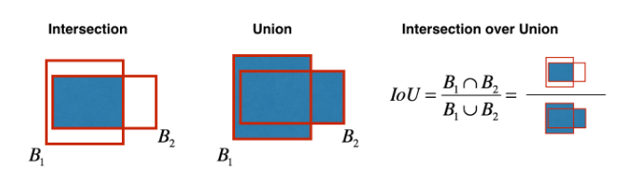
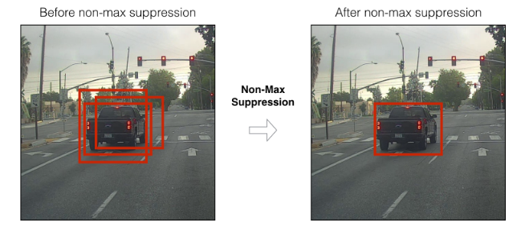
Data Flow Diagrams/Algorithms/Techniques
Abstract
Introduction
Existing System
Proposed System
Software/Hardware Requirements
Modules
Data Flow Diagrams/Algorithms/Techniques
References
Object Detection :

Slide 11
Data Flow Diagrams/Algorithms/Techniques
Abstract
Introduction
Existing System
Proposed System
Software/Hardware Requirements
Modules
Data Flow Diagrams/Algorithms/Techniques
References

Slide 12
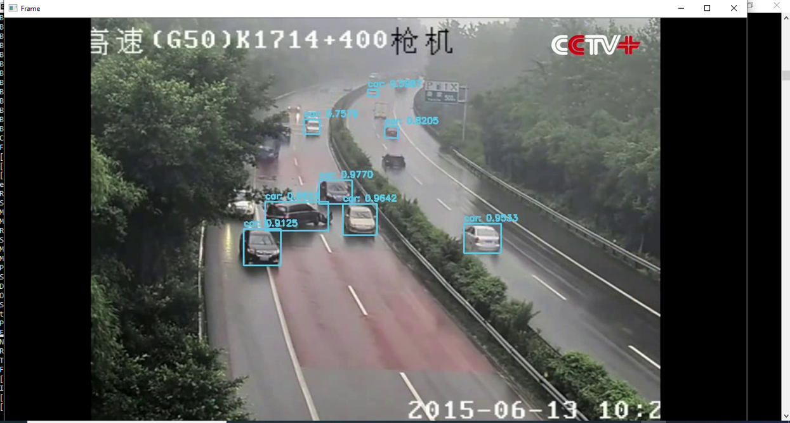
Data Flow Diagrams/Algorithms/Techniques
Abstract
Introduction
Existing System
Proposed System
Software/Hardware Requirements
Modules
Data Flow Diagrams/Algorithms/Techniques
References

Slide 13
Abstract
Introduction
Existing System
Proposed System
Software/Hardware Requirements
Modules
Data Flow Diagrams/Algorithms/Techniques
References
References
Kyu Beom Lee, Hyu Soung Shin Department of Extreme Environment Research Center Department of Extreme Environment Research Center Korea Institute of Civil Engineering and Building Technology (KICT).
University of Science & Technology (UST) Korea Institute of Civil Engineering and Building Technology (KICT) Gyeonggi-Do , The Republic of Korea" An application of a deep learning algorithm for automatic detection of unexpected accidents under bad CCTV monitoring conditions in tunnels" International Conference on Deep Learning and Machine Learning in Emerging Applications Date Added to IEEE Xplore: 21 October 2019 INSPEC Accession Number: 19080528 DOI: 10.1109/Deep-ML.2019.00010

Slide 14
Q and A?
?
THANK YOU

